Slide 1
MES 개발 - 3차년도 연구계획
2016년 4월22일
세부과제 책임자 : 경성대학교, 김후곤(hkim@ks.ac.kr)

Slide 2
MES 개요
재고관리
인사관리
생산관리
MES(Manufacturing Execution System)
BOM Management
BOM 정의, 등록
BOM 검색, 재고, 입출고관리
Process Management(공정관리)
POP 모듈
Open Web Site
Worker Management(작업자관리)
Freeware
작업자 정의, 등록
작업자 검색, 근태, 작업할당

Slide 3
mongo 실행 및 초기작업
1. 회사 관리자 등록
0) mongo 실행
>use admin
>db.createUser(
{
user: "admin",
pwd: "password",
roles: [ { role: "root", db: "admin" } ]
}
);
>db.changeUserPassword('admin','mongotest');
>db.system.users.find();
초기에는 admin, mongotest 로 설정되어 있음
2) momongod –auth 실행
2. 신규 회사 등록
1) mongod 실행
2) mongo 실행
>use login
>db.users.insert(
{
"name" : "경성",
"company_id" : "abcd",
"db_name" : "BOM",
"users" : [],
"projects" :[]
});
를 실행하여, 회사id를 부여함.
3) web 실행(localhost/MES2/index.php)
사용자 등록
project 등록
회사 db 사용자 등록(optional)
>use ecommerce
>var user = {
"user" : "website",
"pwd" : "abc123",
roles : [ { "role" : "readWrite", "db" : "ecommerce" } ]
}
db.createUser(user);

Slide 4
db구조 : login
users
document : {1회사, multi-users, multi-project}
{
"_id" : ObjectId("57c3ee4ab585d41eb7057f48"),
“name" : "부산PC",
"company_id" : "abcd",
"db_name" : "BOM",
"users" : [
{ "_id" : ObjectId("57c54e634ae55f78200000a3"),
"username" : "abc",
"password" : "$2y$10$G.ZMaySa0Lt5TSyopX9/KOf0eWQCwGPuzihPc4sM2Ji3chZ3ww0sC",
"created" : ISODate("2016-08-30T18:14:11.000+09:00")
} {},{},,,,{}
],
"projects" : [
{ "_id" : ObjectId("57bfdf17ed27d12d310c0cbc"),
"created" : ISODate("2016-08-30T18:14:11.000+09:00")
} {},{},,,,{}
]
},{},{},,,,{}
logs
document : {user, any company}
{
"_id" : ObjectId("57c54e634ae55f78200000a3"),
"company__id" : ObjectId("57c3ee4ab585d41eb7057f48"),
"company_name" : "경성",
"company_id" : "abcd",
"username" : "abc",
"logs" : [
{ "type" : "created", "date" : ISODate("2016-08-30T18:14:11.000+09:00") },
{ "type" : "login", "date" : ISODate("2016-08-30T18:20:28.000+09:00") }
]
},{},{},,,,{}
collection
{document size limit:15MB}
{document}, {},{},,,{}

Slide 5
db구조 : MES project
db for 1 company
database
collections
abcd
project
material
document : {1 project, multiple categories}
document : {1 category, multiple materials, any project}
project
material
{
"_id" : ObjectId("57bfdf17ed27d12d310c0cbc"),
"initiated" : true,
"company" : "부산PC",
"project_name" : "BOM",
"BOM_master" : {
"categories" : [
{
"_id" : ObjectId("57a83b0897352492698e1ef0"),
"name" : "PC",
"l_id" : "b0",
"state" : "expanded,
"created" : ISODate("2016-08-26T14:13:37.000+09:00"),
"logs" : []
},{},{},,,{}
]
}
},{},{},,,{}
{
"_id" : ObjectId("57a83b0897352492698e1ef0"),
"project__id" : ObjectId("57bfdf17ed27d12d310c0cbc"),
"materials" : [
{
"_id" : ObjectId("57bfd0014ae55f782000006c"),
"m_id" : "b2001",
"name" : "CPU",
"unit" : "3m",
"spec" : "EA",
"state" : "expanded",
"created" : ISODate("2016-08-26T14:13:37.000+09:00"),
"inventory" : 98,
"io_logs" : [
{"type": "input", "date":”” , "quantity" : 100},
{"type": "output", "date":”” , "quantity" : 100},
{"type": “adjust", "date":”” , "quantity" : -30},
,,,
{}
],
"logs" : []
},{},{},,,{}
]
},{},{},,,,{}

Slide 6
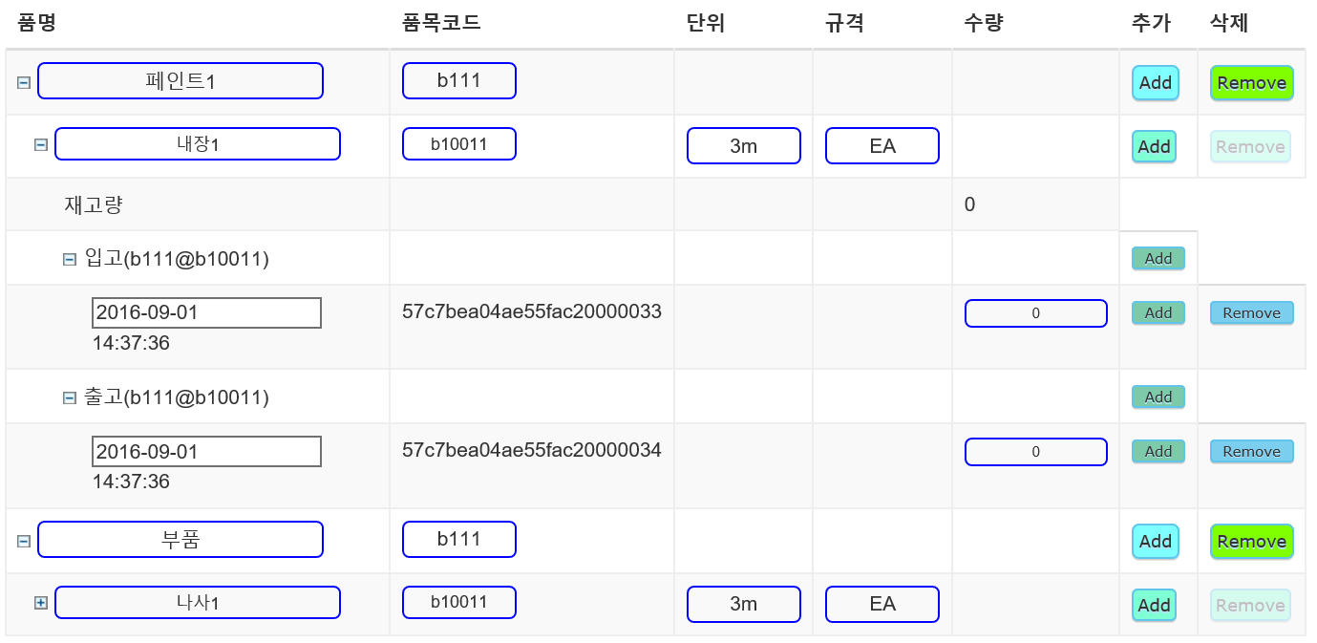
1200
입력
보기
입력
보기
재고조정
입력
보기

Slide 7
시스템개발 : Web App 개발 개념도
Browser(GUI)
Language : HTML5/CSS/Javascript
통합 모형
S/W 시스템
RES 설계/구축
BAU/시나리오 구축
Variable 추가
Constraint 추가
매개변수, 기술변화/보급/확산, 수요, 가격 등
LP generation
MML : GAMS, AMPL, MathProg
LP solver API
MySQL or
MongoDB
기술 DB master
LP file : MPS, LP
LP solver : glpk, CPLEX, Gurobi, COIN-OR
Reporting/Result Analysis
Web viewer : HTML5/CSS/Javascript
LP viewer : MathJax
Batch outputs
Plot/Chart : HTML5 SVG/d3

Slide 8
시스템개발 : SW System/UI 개발 방법론
data/RES 파일 구조 및 표현
JSON
UI 구현
MySQL or
MongoDB
HTML5/CSS3/Javascript
for client
PHP for server
LP 구현/실행
LP viewer
MML(GAMS)
MML(GAMS)
LP API
MathJax
LP Solver
JSON : JavaScript Object Notation
WPF : Windows Presentation
HTML : HyperText Markup Language
CSS : Cascading Style Sheets
MML : Mathematical Modeling Language
GAMS : General Algebraic Modeling System

Slide 9
JSON
JSON(JavaScript Object Notation)
http://json.org/
a lightweight data-interchange format
two structures
object : a collection of name/value pairs
array : an ordered list of values
JSON names require double quotes
JSON values can be:
A number (integer or floating point)
A string (in double quotes)
A Boolean (true or false)
An array (in square brackets)
An object (in curly braces)
null

Slide 10
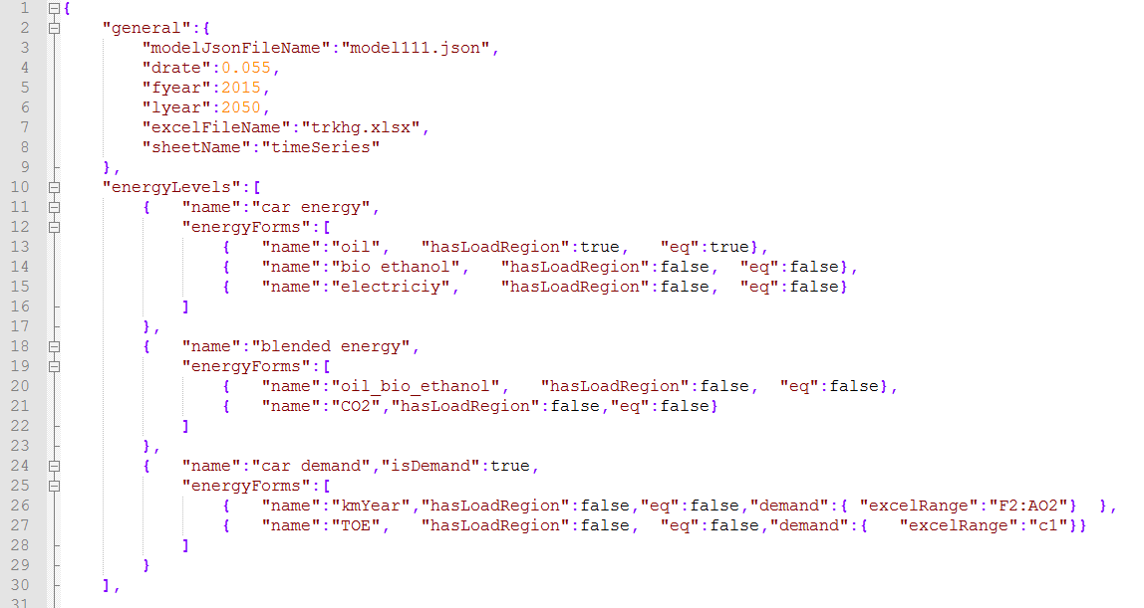
시스템개발 : RES/에너지 폼의 JSON 표현

Slide 11
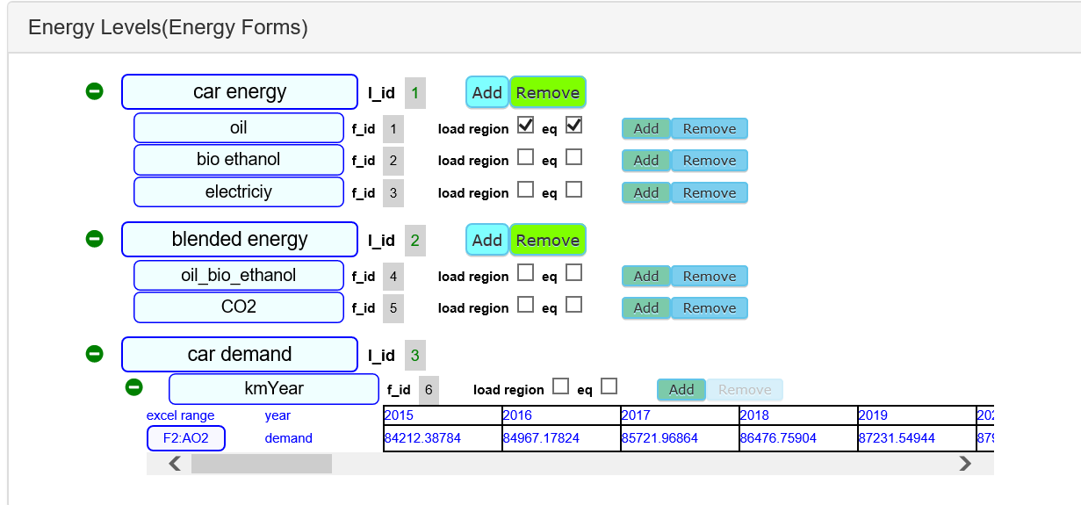
시스템개발 : RES/에너지 폼 UI

Slide 12
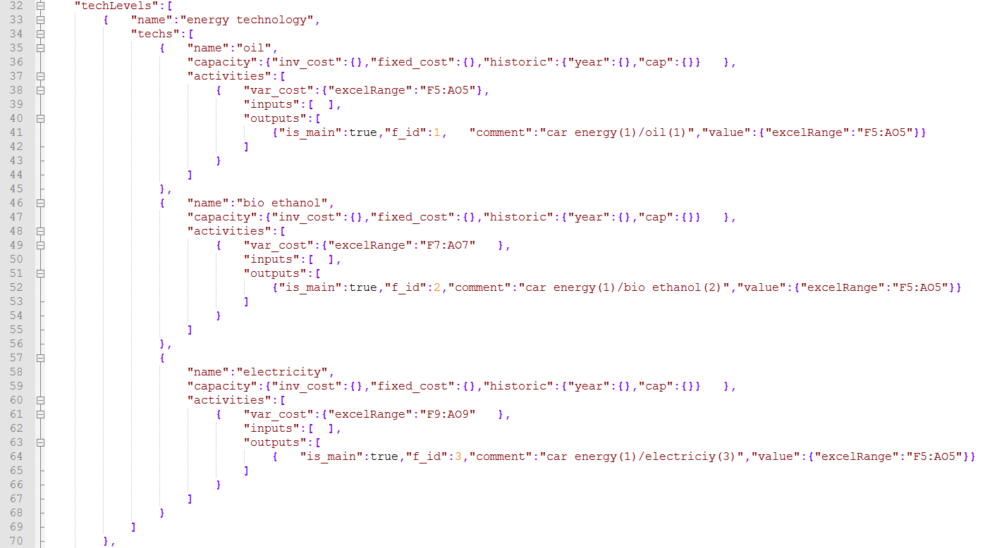
시스템개발 : RES/technology의 JSON 표현

Slide 13
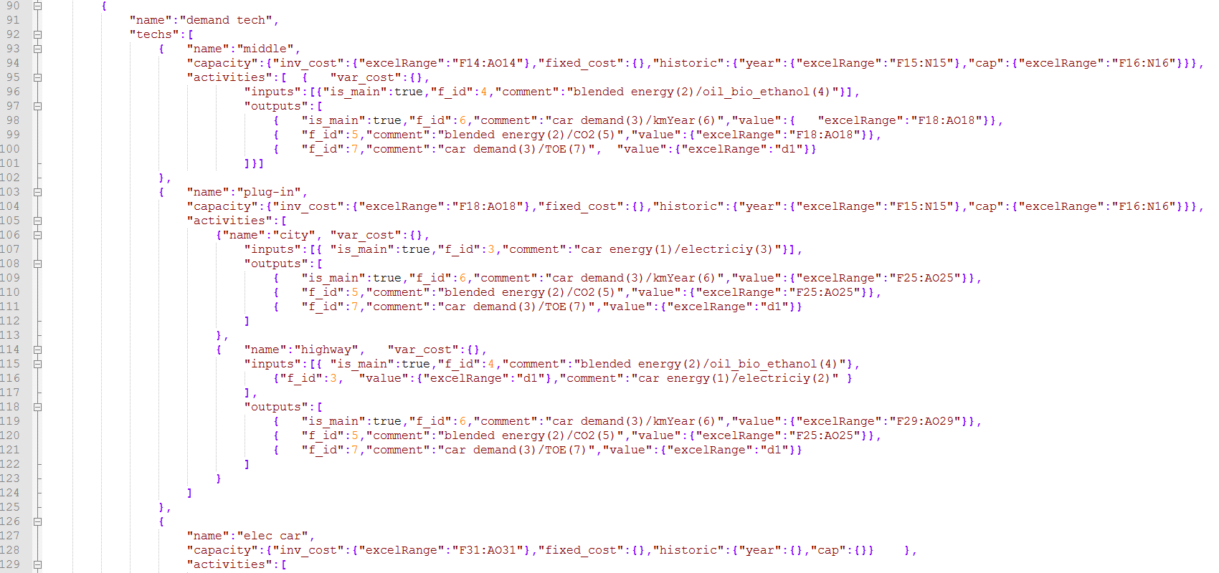
시스템개발 : RES/technology의 JSON 표현

Slide 14
UI를 통한 Viewer/CRUD 구현
UI 구현
Viewer 구현
RES Viewer
LP Viewer
Output Viewer
자료구조 구현
RES 트리구조
Project 자료구조
Viewer를 위한 자료구조
CRUD 구현
Project CRUD
(Create, Read, Update, Delete)
JSON/file/DB
manager
RES CRUD
(Create, Read, Update, Delete)
LP/Output CRUD
(Create, Read, Update, Delete)
상향식 GAMS 코드의 knowhow 활용
(Elec LP with Storage) 테스트
자료구조를 위한 테스트
GAMS/MathProg의 대체가능성 확인
CPLEX/glpk의 대체가능성 확인
Time Series/JSON CRUD
(Create, Read, Update, Delete)

Slide 15
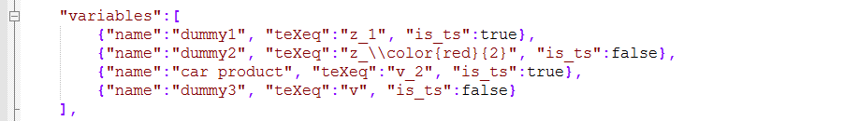
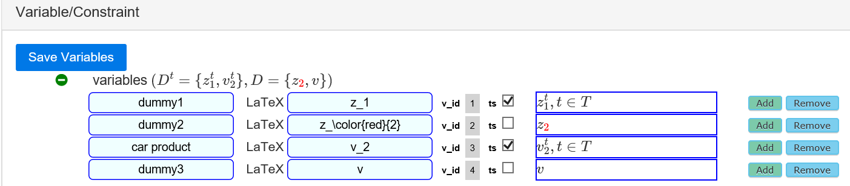
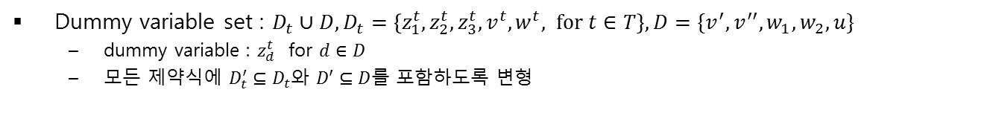
시스템개발 : Dummy variable의 JSON 표현
Dummy variable set : $D_{t}∪D,D_{t}=\left\{z_{1}^{t},z_{2}^{t},z_{3}^{t}, v^{t},w^{t}, for t∈T\right\}, D=\{v^{′},v^{′′},w_{1},w_{2},u\}$
dummy variable : $z_{d}^{t}$ for $d∈D$
모든 제약식에 $D_{t}^{′}⊆D_{t}$와 $D′⊆D$를 포함하도록 변형

Slide 16
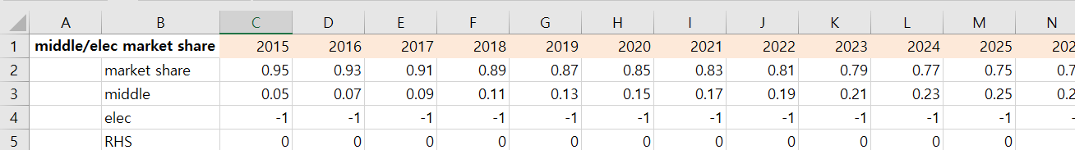



시스템 개발 : 제약식의 구현(type1:yearly)
연도별 제약식(yearly constraint) : $I_{1}^{′}⊆I_{1},I_{2}^{′}⊆I_{2},A_{i}^{′}⊆A_{i}$와 $t=1,2,⋯, T$에 대하여
activity/input constraint
$$\sum_{i∈I_{1}^{′}}{γ_{i}^{t}x_{i}^{t}}+\sum_{i∈I_{2}^{′}}{\sum_{(i,a)∈A_{i}^{′}}{γ_{(i,a)}^{t}x_{(i,a)}^{t}}}+\sum_{d∈D_{t}^{′}}{γ_{d}^{t}z_{d}^{t}}+\sum_{d∈D^{′}}{γ_{d}^{t}z_{d}}≤B^{t}$$
activity/output constraint
$$\sum_{i∈I_{1}^{′}}{γ_{i}^{t}\left(\frac{1}{e_{i}^{t}}x_{i}^{t}\right)}+\sum_{i∈I_{2}^{′}}{\sum_{(i,a)∈A_{i}^{′}}{γ_{(i,a)}^{t}\left(\frac{1}{e_{\left(i,a\right)}^{t}}x_{\left(i,a\right)}^{t}\right)}}+\sum_{d∈D_{t}^{′}}{γ_{d}^{t}z_{d}^{t}}+\sum_{d∈D^{′}}{γ_{d}^{t}z_{d}}≤B^{t}$$
capacity constraint
$$\sum_{i∈I}{γ_{i}^{t}y_{i}^{t}}+\sum_{d∈D_{t}^{′}}{γ_{d}^{t}z_{d}^{t}}+\sum_{d∈D^{′}}{γ_{d}^{t}z_{d}}≤B^{t}$$
Example
Market share : $\frac{y_{middle}^{t}}{y_{middle}^{t}+y_{elec}^{t}}≥{MS}^{t}⟺\left(1−{MS}^{t}\right)y_{middle}^{t}−y_{elec}^{t}≥0$
1 liter
$$i$$
$e_{i}^{t}=10$Km

Slide 17
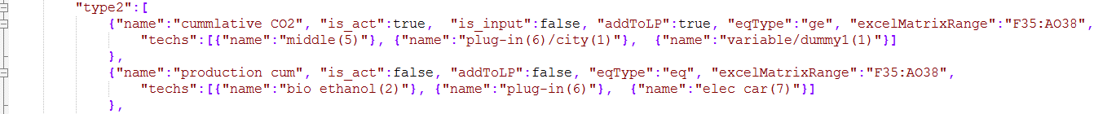

시스템 개발 : 제약식의 구현(type2:cumulative)
연도별 누적 제약식(cumulative constraint) : $I_{1}^{′}⊆I_{1},I_{2}^{′}⊆I_{2},A_{i}^{′}⊆A_{i}$와 $t=1,2,⋯, T$에 대하여
activity/input constraint
$$\sum_{i∈I_{1}^{′}}{\sum_{s=1}^{t}{γ_{i}^{s}x_{i}^{s}}}+\sum_{i∈I_{2}^{′}}{\sum_{(i,a)∈A_{i}^{′}}{\sum_{s=1}^{t}{γ_{(i,a)}^{s}x_{(i,a)}^{s}}}}+\sum_{d∈D_{t}^{′}}{γ_{d}^{t}z_{d}^{t}}+\sum_{d∈D^{′}}{γ_{d}^{t}z_{d}}≤B^{t}$$
activity/output constraint
$$\sum_{i∈I_{1}^{′}}{\sum_{s=1}^{t}{γ_{i}^{s}\left(\frac{1}{e_{i}^{s}}x_{i}^{s}\right)}}+\sum_{i∈I_{2}^{′}}{\sum_{(i,a)∈A_{i}^{′}}{\sum_{s=1}^{t}{γ_{(i,a)}^{s}\left(\frac{1}{e_{\left(i,a\right)}^{s}}x_{\left(i,a\right)}^{s}\right)}}}+\sum_{d∈D_{t}^{′}}{γ_{d}^{t}z_{d}^{t}}+\sum_{d∈D^{′}}{γ_{d}^{t}z_{d}}≤B^{t}$$
capacity constraint
$$\sum_{i∈I^{′}}{\sum_{s=1}^{t}{γ_{i}^{s}x_{i}^{s}}}+\sum_{d∈D_{t}^{′}}{γ_{d}^{t}z_{d}^{t}}+\sum_{d∈D^{′}}{γ_{d}^{t}z_{d}}≤B^{t}$$
Example

Slide 18
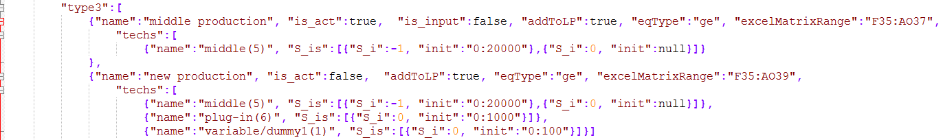
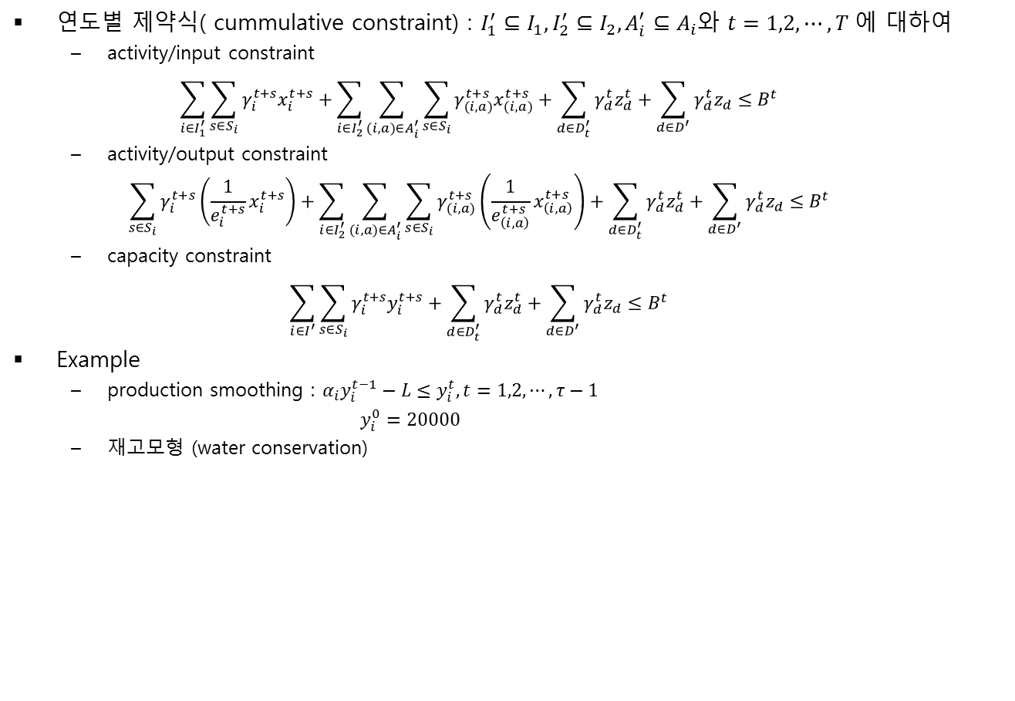
시스템 개발 : 제약식의 구현(type3:time series)
연도별 제약식( cummulative constraint) : $I_{1}^{′}⊆I_{1},I_{2}^{′}⊆I_{2},A_{i}^{′}⊆A_{i}$와 $t=1,2,⋯, T$에 대하여
activity/input constraint
$$\sum_{i∈I_{1}^{′}}{\sum_{s∈S_{i}}{γ_{i}^{t+s}x_{i}^{t+s}}}+\sum_{i∈I_{2}^{′}}{\sum_{(i,a)∈A_{i}^{′}}{\sum_{s∈S_{i}}{γ_{(i,a)}^{t+s}x_{(i,a)}^{t+s}}}}+\sum_{d∈D_{t}^{′}}{γ_{d}^{t}z_{d}^{t}}+\sum_{d∈D^{′}}{γ_{d}^{t}z_{d}}≤B^{t}$$
activity/output constraint
$$\sum_{s∈S_{i}}{γ_{i}^{t+s}\left(\frac{1}{e_{i}^{t+s}}x_{i}^{t+s}\right)}+\sum_{i∈I_{2}^{′}}{\sum_{(i,a)∈A_{i}^{′}}{\sum_{s∈S_{i}}{γ_{(i,a)}^{t+s}\left(\frac{1}{e_{\left(i,a\right)}^{t+s}}x_{\left(i,a\right)}^{t+s}\right)}}}+\sum_{d∈D_{t}^{′}}{γ_{d}^{t}z_{d}^{t}}+\sum_{d∈D^{′}}{γ_{d}^{t}z_{d}}≤B^{t}$$
capacity constraint
$$\sum_{i∈I^{′}}{\sum_{s∈S_{i}}{γ_{i}^{t+s}y_{i}^{t+s}}}+\sum_{d∈D_{t}^{′}}{γ_{d}^{t}z_{d}^{t}}+\sum_{d∈D^{′}}{γ_{d}^{t}z_{d}}≤B^{t}$$
Example
production smoothing : $α_{i}y_{i}^{t−1}−L≤y_{i}^{t}, t=1,2,⋯,τ−1$
$y_{i}^{0}=20000$
재고모형 (water conservation)

Slide 19
시스템개발 : LP의 최적화 및 LP Viewer 구현
LP Engine
LP Viewer
Framework
LP Tree viewer
MML(GAMS)
LP API
LP Generation
(cplex LP format)
MathJax
LP Solver

